Slide 1
Smart gloves
Enabling people with speaking disabilities to communicate with ease.

Slide 2
Motivation
Approximately 7.5 million people in the United States have trouble using their voices.
The prevalence of speech sound disorder in young children is 8 to 9 percent.
It is estimated that more than 3 million Americans stutter.

Slide 3
Objective
Developing a cost effective wearable technology that converts sign language used by people with speaking disabilities to communicate with ease.
To cut short the overhead of having a third person sign language interpreter/translator.

Slide 4
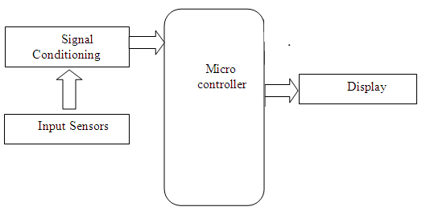
Block diagram

Slide 5
Components

Slide 6
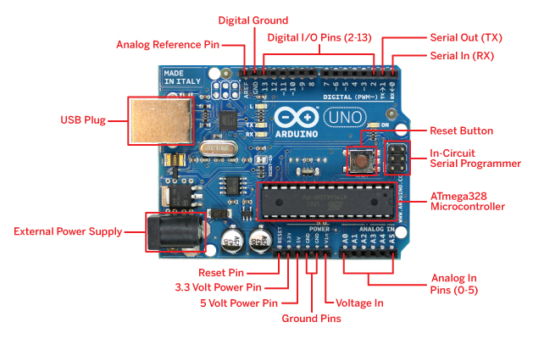
Arduino UNO board

Slide 7
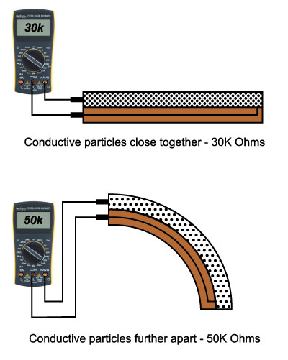
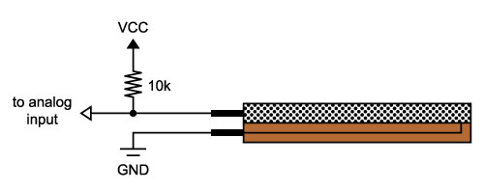
Flex sensors

Slide 8
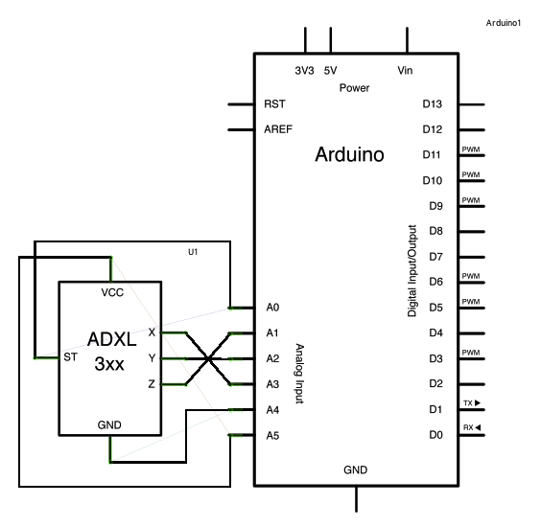
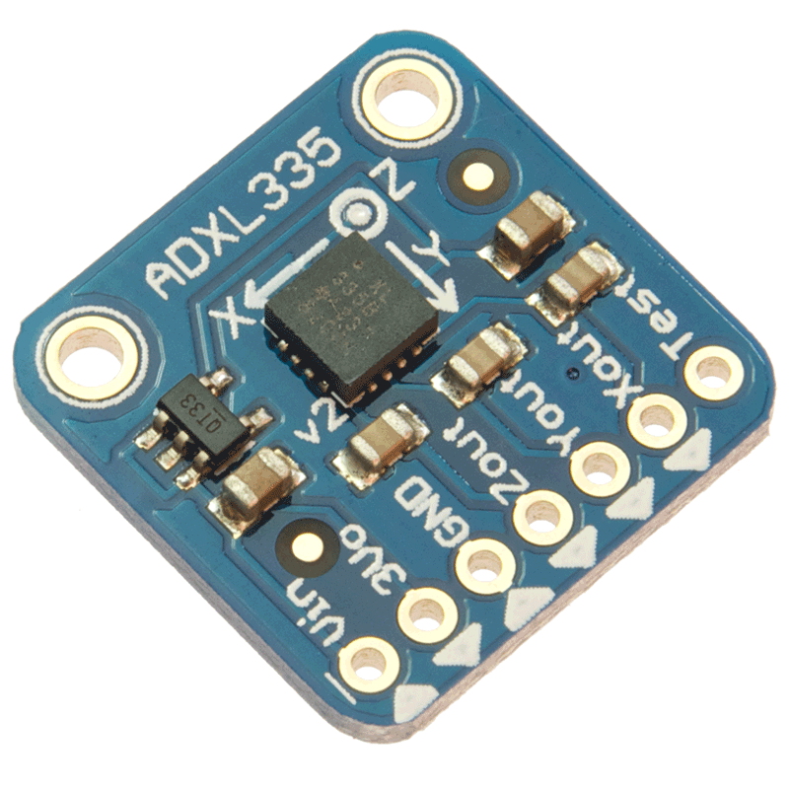
Accelerometer

Slide 9
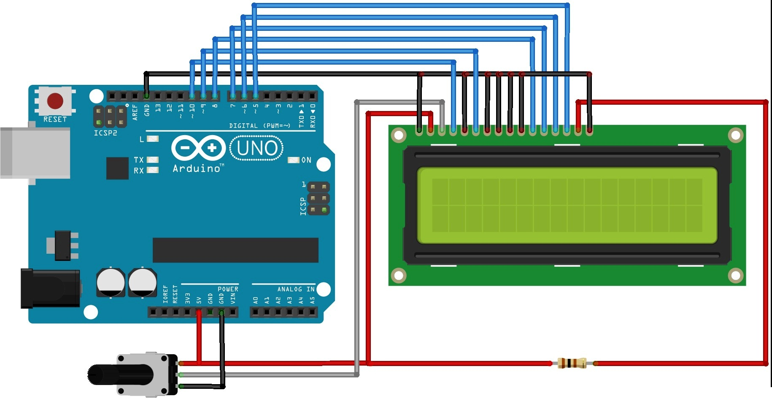
Lcd (16X2)

Slide 10
CONCLUSION
The prototype is a cost effective solution for the identified problem.
We have correctly identified the sensors and the components required to build the prototype.

Slide 11
References
Stats - http://www.nidcd.nih.gov/health/statistics/pages/vsl.aspx
Flex Sensors - http://www.sparkfun.com/tutorials/270
Accelerometer - https://www.arduino.cc/en/Tutorial/ADXL3xx

